Slide 1

Memory Networks for Language Understanding
Jason Weston
Facebook AI Research

Slide 2
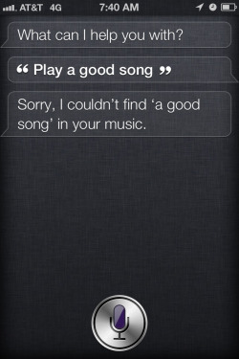
Intelligent Conversational Agents

Slide 3
End-to-End Dialog Agents
While it is possible to build useful dialog agents as a set of separate black boxes with joining logic (Google Now, Cortana, Siri, .. ?) we believe a true dialog agent should:
Be able to combine all its knowledge to fulfill complex tasks.
Handle long open-ended conversations involving effectively tracking many latent variables.
Be able to learn (new tasks) via conversation.
Our bet: Machine Learning End-to-End systems is the way forward in the long-run.

Slide 4
Memory Networks
Class of models that combine large memory with learning component that can read and write to it.
Incorporates reasoning with attention over memory (RAM).
Most ML has limited memory which is more-or-less all that’s needed for “low level” tasks e.g. object detection.
Our motivation: long-term memory is required to read a story and then e.g. answer questions about it.
Similarly, it’s also required for dialog: to remember previous dialog (short- and long-term), and respond.
We first test this on the toy (bAbI) tasks.
Any interesting model has to be good on real data as well.

Slide 5
Memory Networks

Slide 6
Evaluating End-To-End Learners
Long Term goal: A learner can be trained (from scratch?) to understand and use language.
Our main interest: uncover the learning algorithms able to do so.
Inspired by “A Roadmap towards Machine Intelligence” (Mikolov, Joulin, Baroni 2015) we advocate a set of tasks to train & evaluate on:
Classic Language Modeling (Penn TreeBank, Text8)
Story understanding (Children’s Book Test, News articles)
Open Question Answering (WebQuestions, WikiQA)
Goal-Oriented Dialog and Chit-Chat (Movie Dialog, Ubuntu)

Slide 7
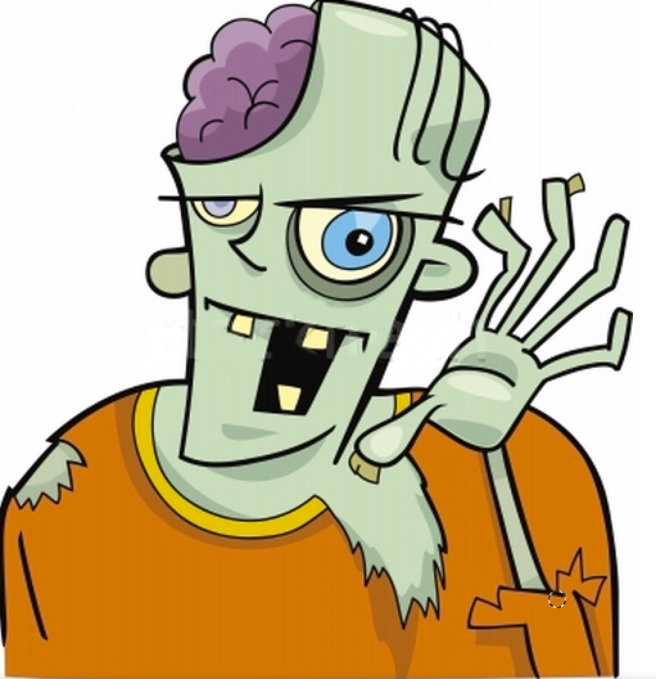
What is a Memory Network? Original paper description of class of models
MemNNs have four component networks (which may or may not have shared parameters):
I: (input feature map) convert incoming data to the internal feature representation.
G: (generalization) update memories given new input.
O: produce new output (in feature representation space) given the memories.
R: (response) convert output O into a response seen by the outside world.

Slide 8
Some Memory Network- related Publications
J. Weston, S. Chopra, A. Bordes. Memory Networks. ICLR 2015 (and arXiv:1410.3916).
S. Sukhbaatar, A. Szlam, J. Weston, R. Fergus. End-To-End Memory Networks. NIPS 2015 (and arXiv:1503.08895).
J. Weston, A. Bordes, S. Chopra, A. M. Rush, B. van Merriënboer, A. Joulin, T. Mikolov. Towards AI-Complete Question Answering: A Set of Prerequisite Toy Tasks. arXiv:1502.05698.
A. Bordes, N. Usunier, S. Chopra, J. Weston. Large-scale Simple Question Answering with Memory Networks. arXiv:1506.02075.
J. Dodge, A. Gane, X. Zhang, A. Bordes, S. Chopra, A. Miller, A. Szlam, J. Weston. Evaluating Prerequisite Qualities for Learning End-to-End Dialog Systems. arXiv:1511.06931.
F. Hill, A. Bordes, S. Chopra, J. Weston. The Goldilocks Principle: Reading Children's Books with Explicit Memory Representations. arXiv:1511.02301.
J. Weston. Dialog-based Language Learning. arXiv:1604.06045.
A. Bordes, Jason Weston. Learning End-to-End Goal-Oriented Dialog. arXiv:1605.07683.

Slide 9
Memory Network Models implemented models..
[Figure by Saina Sukhbaatar]

Slide 10
Variants of the class…
Some options and extensions:
Representation of inputs and memories could use all kinds of encodings: bag of words, RNN style reading at word or character level, etc.
Different possibilities for output module: e.g. multi-class classifier or uses an RNN to output sentences.
If the memory is huge (e.g. Wikipedia) we need to organize the memories. Solution: hash the memories to store in buckets (topics). Then, memory addressing and reading doesn’t operate on all memories.
If the memory is full, there could be a way of removing one it thinks is most useless; i.e. it ``forgets’’ somehow. That would require a scoring function of the utility of each memory..

Slide 11
Task (1) Factoid QA with Single Supporting Fact (“where is actor”)
(Very Simple) Toy reading comprehension task:
John was in the bedroom.
Bob was in the office.
John went to kitchen.
Bob travelled back home.
Where is John? A:kitchen
SUPPORTING FACT

Slide 12
(2) Factoid QA with Two Supporting Facts (“where is actor+object”)
A harder (toy) task is to answer questions where two supporting statements have to be chained to answer the question:
John is in the playground.
Bob is in the office.
John picked up the football.
Bob went to the kitchen.
Where is the football? A:playground
Where was Bob before the kitchen? A:office

Slide 13
(2) Factoid QA with Two Supporting Facts (“where is actor+object”)
A harder (toy) task is to answer questions where two supporting statements have to be chained to answer the question:
John is in the playground.
Bob is in the office.
John picked up the football.
Bob went to the kitchen.
Where is the football? A:playground
Where was Bob before the kitchen? A:office
SUPPORTING FACT
SUPPORTING FACT
To answer the first question Where is the football? both John picked up the football and John is in the playground are supporting facts.
.

Slide 14
Memory Network Models implemented models
[Figure by Saina Sukhbaatar]

Slide 15
The First MemNN Implemention
I (input): converts to bag-of-word-embeddings x.
G (generalization): stores x in next available slot m_{N}.
O (output): Loops over all memories k=1 or 2 times:
1st loop max: finds best match m_{i} with x.
2nd loop max: finds best match m_{J} with (x, m_{i}).
The output o is represented with (x, m_{i,} m_{J}).
R (response): ranks all words in the dictionary given o and returns best single word. (OR: use a full RNN here)

Slide 16
Matching function
For a given Q, we want a good match to the relevant memory slot(s) containing the answer, e.g.:
Match(Where is the football ?, John picked up the football)
We use a q^{T}U^{T}Ud embedding model with word embedding features:
LHS features: Q:Where Q:is Q:the Q:football Q:?
RHS features: D:John D:picked D:up D:the D:football QDMatch:the QDMatch:football
(QDMatch:football is a feature to say there’s a Q&A word match, which can help.)
The parameters U are trained with a margin ranking loss: supporting facts should score higher than non-supporting facts.

Slide 17
Matching function: 2nd hop
On the 2nd hop we match question & 1st hop to new fact:
Match( [Where is the football ?, John picked up the football], J John is in the playground)
We use the same q^{T}U^{T}Ud embedding model:
LHS features: Q:Where Q:is Q:the Q:football Q:? Q2: John Q2:picked Q2:up Q2:the Q2:football
RHS features: D:John D:is D:in D:the D:playground QDMatch:the QDMatch:is .. Q2DMatch:John

Slide 18
Objective function
Minimize:
Where: S_{O} is the matching function for the Output component.
S_{R} is the matching function for the Response component.
x is the input question.
m_{O1} is the first true supporting memory (fact).
m_{O2} is the first second supporting memory (fact).
r is the response
True facts and responses m_{O1,} m_{O2} and r should have higher scores than all other facts and responses by a given margin.

Slide 19
Comparing triples
We also need time information for the bAbI tasks. We tried adding absolute time as a feature: it works, but the following idea can be better:
Seems to work better if we compare triples:
Match(Q,D,D’) returns < 0 if D is better than D’
returns > 0 if D’ is better than D
We can loop through memories, keep best m_{i} at each step.
Now the features include relative time features:
L.H.S: same as before
R.H.S: features(D) DbeforeQ:0-or-1
-features(D’) D’beforeQ:0-or-1 DbeforeD’:0-or-1

Slide 20
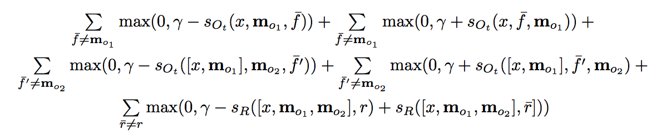
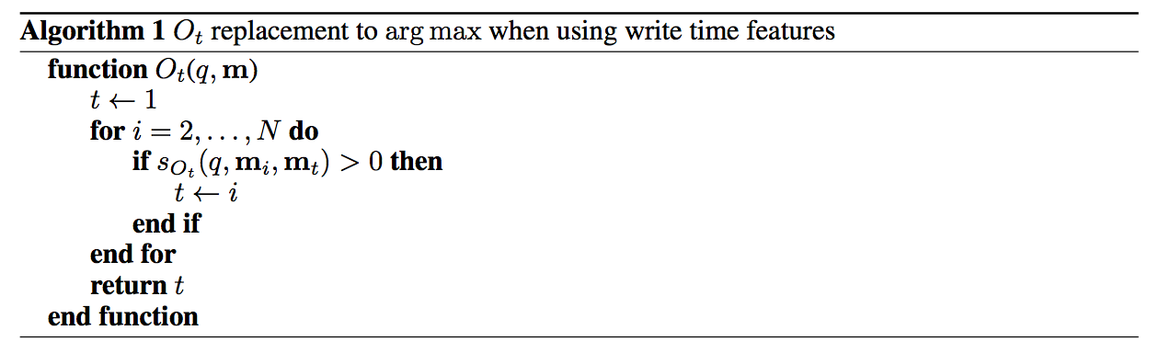
Comparing triples: Objective and Inference
Similar to before, except now for both m_{o1} and m_{o2} we need to have two terms considering them as the second or third argument to the S_{Ot} as they may appear on either side during inference:

Slide 21
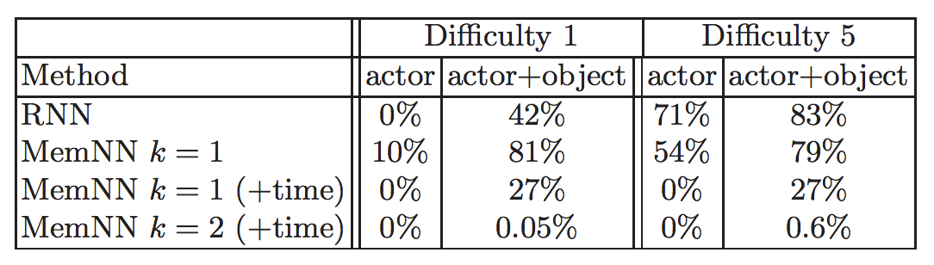
bAbI Experiment 1
10k sentences. (Actor: only ask questions about actors.)
Difficulty: how many sentences in the past when entity mentioned.
Fully supervised (supporting sentences are labeled).
Compare RNN (no supervision)
and MemNN hops k = 1 or 2, & with/without time features.
Difficulty 5 -- Max mem. sz. required: 65 Average mem. sz. required: 9

Slide 22
bAbI Experiment 1
Example test story + predictions:
Antoine went to the kitchen. Antoine got the milk. Antoine travelled to the office. Antoine dropped the milk. Sumit picked up the football. Antoine went to the bathroom. Sumit moved to the kitchen.
where is the milk now? A: office
where is the football? A: kitchen
where is Antoine ? A: bathroom
where is Sumit ? A: kitchen
where was Antoine before the bathroom? A: office

Slide 23
Unsegmented setup; R module is an RNN
Joe went to the garden then Fred picked up the milk; Joe moved to the bathroom and Fred dropped the milk, and then Dan moved to the living room.
Where is Dan? A: living room I believe
Where is Joe? A: the bathroom
Fred moved to the bedroom and Joe went to the kitchen then Joe took the milk there and Dan journeyed to the bedroom; Joe discarded the milk.
Where is the milk now? A: the milk is in the kitchen
Where is Dan now? A: I think he is in the bedroom
Joe took the milk there, after that Mike travelled to the office, then Joe went to the living room, next Dan went back to the kitchen and Joe travelled to the office.
Where is Joe now? A: I think Joe is in the office

Slide 24
Larger QA: Reverb Dataset in (Fader et al., 13)
14M statements, stored as (subject, relation, object) triples. Triples are REVERB extractions mined from ClueWeb09.
Statements cover diverse topics:
(milne, authored, winnie-the-pooh)
(sheep, be-afraid-of, wolf), etc...
Weakly labeled QA pairs and 35M paraphrased questions from WikiAnswers:
``Who wrote the Winnie the Pooh books?
``Who is poohs creator?’’

Slide 25
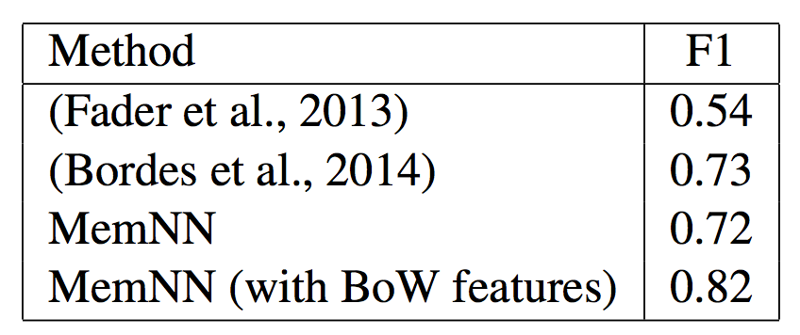
Results: QA on Reverb data from (Fader et al.)
14M statements stored in the memNN memory.
k=1 loops MemNN, 128-dim embedding.
R response simply outputs top scoring statement.
Time features are not necessary, hence not used.
We also tried adding bag of words (BoW) features.

Slide 26
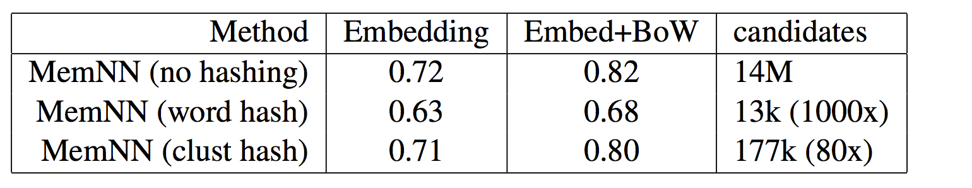
Fast QA on Reverb data
Scoring all 14M candidates in the memory is slow.
We consider speedups using hashing in S and O as mentioned earlier:
Hashing via words (essentially: inverted index)
Hashing via k-means in embedding space (k=1000)

Slide 27
A MemNN multitasked on bAbI data and Reverb QA data
The “story” told to the model after training:
Antoine went to the kitchen. Antoine picked up the milk. Antoine travelled to the office.
MemNN’s answers to some questions:
Where is the milk? A: office
Where was Antoine before the office? A: kitchen
Where does milk come from? A: milk come from cow
What is a cow a type of? A: cow be female of cattle
Where are cattle found? A: cattle farm become widespread in brazil
What does milk taste like? A: milk taste like milk
What does milk go well with? A: milk go with coffee

Slide 28
Related Memory Models (published before or ~same time as original paper)
RNNSearch (Bahdanau et al.) for Machine Translation
Can be seen as a Memory Network where memory goes back only one sentence (writes embedding for each word).
At prediction time, reads memory and performs a soft max to find best alignment (most useful words). 1 hop only.
Generating Sequences With RNNs (Graves, ‘13)
Also does alignment with previous sentence to generate handwriting (so RNN knows what letter it’s currently on).
Neural Turing Machines (Graves et al., 14) [on arxiv just 5 days after MemNNs!]
Has read and write operations over memory to perform tasks (e.g. copy, sort, associative recall).
128 memory slots in experiments; content addressing computes a score for each slot ➔ slow for large memory?
Earlier work by (Das ‘92), (Schmidhuber et al., 93), DISCERN (Miikkulainen, ‘90) and others...

Slide 29
Learning of Basic Algorithms using Reasoning, Attention, Memory (RAM) (e.g. addition, multiplication, sorting)
Methods include adding stacks and addressable memory to RNNs:
“Neural Net Architectures for Temporal Sequence Processing.” M. Mozer.
“Neural Turing Machines” A. Graves, G. Wayne, I. Danihelka.
“Inferring Algorithmic Patterns with Stack Augmented Recurrent Nets.” A. Joulin, T. Mikolov.
“Learning to Transduce with Unbounded Memory” E. Grefenstette et al.
“Neural Programmer-Interpreters” S. Reed, N. de Freitas.
“Reinforcement Learning Turing Machine.” W. Zaremba and I. Sutskever.
“Learning Simple Algorithms from Examples” W. Zaremba, T. Mikolov, A. Joulin, R. Fergus.
“The Neural GPU and the Neural RAM machine” I. Sutskever.

Slide 30
Classic NLP tasks for RAM
Classic Language Modeling:
“Long short-term memory” Sepp Hochreiter, Jürgen Schmidhuber.
Machine translation:
“Sequence to Sequence Learning with Neural Networks” I. Sutskever, O. Vinyals, Q. Le.
“Neural Machine Translation by Jointly Learning to Align and Translate” D. Bahdanau, K. Cho, Y. Bengio.
Parsing:
“Grammar as a Foreign Language” O. Vinyals, L. Kaiser, T. Koo, S. Petrov, I. Sutskever, G. Hinton.
Entailment:
“Reasoning about Entailment with Neural Attention” T. Rocktäschel, E. Grefenstette, K. Hermann, T. Kočiský, P. Blunsom.
Summarization:
“A Neural Attention Model for Abstractive Sentence Summarization” A. M. Rush, S. Chopra, J. Weston.

Slide 31
Reasoning with synthetic language
“A Roadmap towards Machine Intelligence” T. Mikolov, A. Joulin, M. Baroni.
“Towards AI-Complete Question Answering: A Set of Prerequisite Toy Tasks” J. Weston, A. Bordes, S. Chopra, A.. Rush, B. van Merriënboer, A. Joulin, T. Mikolov.
Several new models that attempt to solve bAbI tasks:
“Dynamic Memory Networks for Natural Language Processing” A. Kumar, O. Irsoy, P. Ondruska, M. Iyyer, J. Bradbury, I. Gulrajani, R. Socher.
“Towards Neural Network-based Reasoning” B. Peng, Z. Lu, H. Li, K. Wong.
“End-To-End Memory Networks” S. Sukhbaatar, A. Szlam, J. Weston, R. Fergus.

Slide 32
New NLP Datasets for RAM
Understanding news articles:
“Teaching Machines to Read and Comprehend” K. Hermann, T. Kočiský, E. Grefenstette, L. Espeholt, W. Kay, M. Suleyman, P. Blunsom.
Understanding children’s books:
“The Goldilocks Principle: Reading Children's Books with Explicit Memory Representations” F. Hill, A. Bordes, S. Chopra, J. Weston.
Conducting Dialog:
“Hierarchical Neural Network Generative Models for Movie Dialogues” I. Serban, A. Sordoni, Y. Bengio, A. Courville, J. Pineau.
“A Neural Network Approach to Context-Sensitive Generation of Conversational Responses” Sordoni et al.
“Neural Responding Machine for Short-Text Conversation” L. Shang, Z. Lu, H.Li.
“Evaluating Prerequisite Qualities for Learning End-to-End Dialog Systems” J. Dodge, A. Gane, X. Zhang, A. Bordes, S. Chopra, A. Miller, A. Szlam, J. Weston.
General Question Answering:
“Large-scale Simple Question Answering with Memory Networks” A. Bordes, N. Usunier, S. Chopra, J. Weston.

Slide 33
What was next for MemNNs?
Make the language much harder: coreference, conjunctions, negations, etc. etc – will it work?
MemNNs that reason with more than 2 supporting memories.
End-to-end? (doesn’t need supporting facts)
More useful applications on real datasets.
Dialog: Ask questions? Say statements?
Do MemNN ideas extend to other ML tasks and model variants, .e.g. visual QA, perform actions…? [A: yes!].

Slide 34
bAbI tasks: what reasoning tasks would we like models to work on?
We define 20 tasks (generated by the simulation) that we can test new models on. (See: http://fb.ai/babi)
The idea is they are a bit like software tests: each task checks if an ML system has a certain skill.
We would like each “skill” we check to be a natural task for humans w.r.t. text understanding & reasoning, humans should be able to get 100%.
J. Weston, A. Bordes, S. Chopra, T. Mikolov. Towards AI-Complete Question Answering: A Set of Prerequisite Toy Tasks. arXiv:1502.05698.

Slide 37
Task (1) Factoid QA with Single Supporting Fact (“where is actor”)
Our first task consists of questions where a single supporting fact, previously given, provides the answer.
We test simplest case of this, by asking for the location of a person.
A small sample of the task is thus:
We could use supporting facts for supervision at training time, but are not known at test time (we call this “strong supervision”). However weak supervision is much better!!
John is in the playground.
Bob is in the office.
Where is John? A:playground
SUPPORTING FACT

Slide 38
(2) Factoid QA with Two Supporting Facts (“where is actor+object”)
A harder task is to answer questions where two supporting statements have to be chained to answer the question:
John is in the playground.
Bob is in the office.
John picked up the football.
Bob went to the kitchen.
Where is the football? A:playground
SUPPORTING FACT
SUPPORTING FACT
To answer the question Where is the football? both John picked up the football and John is in the playground are supporting facts.
.

Slide 39
(3) Factoid QA with Three Supporting Facts
Similarly, one can make a task with three supporting facts:
John picked up the apple.
John went to the office.
John went to the kitchen.
John dropped the apple.
Where was the apple before the kitchen? A:office
The first three statements are all required to answer this.

Slide 40
(4) Two Argument Relations: Subject vs. Object
To answer questions the ability to differentiate and recognize subjects and objects is crucial.
We consider the extreme case: sentences feature re-ordered words:
The office is north of the bedroom.
The bedroom is north of the bathroom.
What is north of the bedroom? A:office
What is the bedroom north of? A:bathroom
Note that the two questions above have exactly the same words, but in a different order, and different answers.
So a bag-of-words will not work.

Slide 41
(6) Yes/No Questions
This task tests, in the simplest case possible (with a single supporting fact) the ability of a model to answer true/false type questions:
John is in the playground.
Daniel picks up the milk.
Is John in the classroom? A:no
Does Daniel have the milk? A:yes

Slide 42
(8) Lists/Sets
(7) Counting
Tests ability to count sets:
Daniel picked up the football.
Daniel dropped the football.
Daniel got the milk.
Daniel took the apple.
How many objects is Daniel holding? A:two
Tests ability to produce lists/sets:
Daniel picks up the football.
Daniel drops the newspaper.
Daniel picks up the milk.
What is Daniel holding? A:milk,football

Slide 43
(11) Basic Coreference (nearest referent)
Daniel was in the kitchen.
Then he went to the studio.
Sandra was in the office.
Where is Daniel? A:studio
(13) Compound Coreference
Daniel and Sandra journeyed to the office.
Then they went to the garden.
Sandra and John travelled to the kitchen.
After that they moved to the hallway.
Where is Daniel? A:garden

Slide 44
(14) Time manipulation
While our tasks so far have included time implicitly in the order of the statements, this task tests understanding the use of time expressions within the statements:
In the afternoon Julie went to the park.
Yesterday Julie was at school.
Julie went to the cinema this evening.
Where did Julie go after the park? A:cinema
Much harder difficulty: adapt a real time expression labeling dataset into a question answer format, e.g. Uzzaman et al., ‘12.

Slide 45
(15) Basic Deduction
This task tests basic deduction via inheritance of properties:
Sheep are afraid of wolves.
Cats are afraid of dogs.
Mice are afraid of cats.
Gertrude is a sheep.
What is Gertrude afraid of? A:wolves
Deduction should prove difficult for MemNNs because it effectively involves search, although our setup might be simple enough for it.

Slide 46
(17) Positional Reasoning
This task tests spatial reasoning, one of many components of the classical SHRDLU system:
The triangle is to the right of the blue square.
The red square is on top of the blue square.
The red sphere is to the right of the blue square.
Is the red sphere to the right of the blue square? A:yes
Is the red square to the left of the triangle? A:yes

Slide 47
(18) Reasoning about size
This tasks requires reasoning about relative size of objects and is inspired by the commonsense reasoning examples in the Winograd schema challenge:
The football fits in the suitcase.
The suitcase fits in the cupboard.
The box of chocolates is smaller than the football.
Will the box of chocolates fit in the suitcase? A:yes
Tasks 3 (three supporting facts) and 6 (Yes/No) are prerequisites.

Slide 48
(19) Path Finding
In this task the goal is to find the path between locations:
The kitchen is north of the hallway.
The den is east of the hallway.
How do you go from den to kitchen? A:west,north
This is going to prove difficult for MemNNs because it effectively involves search.

Slide 49
What models could we try?
Classic NLP cascade e.g. SVM-struct with bunch of features for subtasks: (Not End-to-End)
N-gram models with SVM-type classifier?
(LSTM) Recurrent Neural Nets?
Memory Network variants … ?
<Insert your new model here>

Slide 50
End-to-end Memory Network (MemN2N)
New end-to-end (MemN2N) model (Sukhbaatar ‘15):
Reads from memory with soft attention
Performs multiple lookups (hops) on memory
End-to-end training with backpropagation
Only need supervision on the final output
It is based on “Memory Networks” by [Weston, Chopra & Bordes ICLR 2015] but that had:
Hard attention
requires explicit supervision of attention during training
Only feasible for simple tasks
Notes:
In this work …
Merge references
Add memn2n

Slide 51
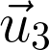
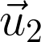
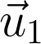
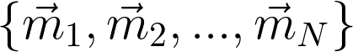
MemN2N architecture
supervision
Output
read
addressing
Controller module
Memory Module
read
addressing
Memory vectors
(unordered)
Internal state
vector
Input
Notes:
The model consists from two parts
…
Let take a closer look at memory module

Slide 52
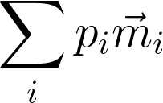

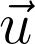
Memory Module
Weighted Sum
Attention weights
/ Soft address
To controller
(added to
controller state)
Softmax
Dot Product
Addressing signal
(controller
state vector)
Memory vectors
Notes:
Lets take closer look at memory module
…

Slide 53
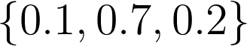
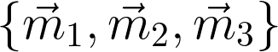
Question & Answering
Answer
kitchen
Memory Module
Weighted Sum
Controller
Dot product + softmax
1: Sam moved to garden
2: Sam went
to kitchen
3: Sam drops
apple there
Where is Sam?
Question
Input story
Notes:
Here we are applying our model to QA task
But note that it can be used in other tasks such as lang model

Slide 54
Memory Vectors
E.g.) constructing memory vectors with Bag-of-Words (BoW)
Embed each word
Sum embedding vectors
Embedding Vectors
Memory Vector
E.g.) temporal structure: special words for time and include them in BoW
Time embedding
\text{1: ``Sam drops apple''}\rightarrow v_\text{{\color{Red} Sam}} + v_\text{{\color{Red} drops}} + v_\text{{\color{Red} apple}} + v_\text{{\color{DarkGreen} 1}} = m_1
Notes:
So far I haven’t told you about how we put things in memory
Memory vectors can take many forms
But let me give you one example when inputs are ..
…
Sometimes data might have a structure
Then you have to include them in memory vectors
Time stamp … corresponding embedding vector

Slide 55
Positional Encoding of Words
Representation of inputs and memories could use all kinds of encodings: bag of words, RNN style reading at word or character level, etc.
We also built a positional encoding variant:
Words are represented by vectors as before.
But instead of a bag, position is modeled by a multiplicative term on each word vector with weights depending on the position in the sentence.

Slide 56
Training on 1k stories
Weakly supervised
Supervised Supp. Facts
TASK | N-grams | LSTMs | MemN2N | Memory Networks | StructSVM+coref+srl
T1. Single supporting fact | 36 | 50 | PASS | PASS | PASS
T2. Two supporting facts | 2 | 20 | 87 | PASS | 74
T3. Three supporting facts | 7 | 20 | 60 | PASS | 17
T4. Two arguments relations | 50 | 61 | PASS | PASS | PASS
T5. Three arguments relations | 20 | 70 | 87 | PASS | 83
T6. Yes/no questions | 49 | 48 | 92 | PASS | PASS
T7. Counting | 52 | 49 | 83 | 85 | 69
T8. Sets | 40 | 45 | 90 | 91 | 70
T9. Simple negation | 62 | 64 | 87 | PASS | PASS
T10. Indefinite knowledge | 45 | 44 | 85 | PASS | PASS
T11. Basic coreference | 29 | 72 | PASS | PASS | PASS
T12. Conjunction | 9 | 74 | PASS | PASS | PASS
T13. Compound coreference | 26 | PASS | PASS | PASS | PASS
T14. Time reasoning | 19 | 27 | PASS | PASS | PASS
T15. Basic deduction | 20 | 21 | PASS | PASS | PASS
T16. Basic induction | 43 | 23 | PASS | PASS | 24
T17. Positional reasoning | 46 | 51 | 49 | 65 | 61
T18. Size reasoning | 52 | 52 | 89 | PASS | 62
T19. Path finding | 0 | 8 | 7 | 36 | 49
T20. Agent’s motivation | 76 | 91 | PASS | PASS | PASS

Slide 57
Attention during memory lookups
Samples from toy QA tasks
 | Test Acc | Failed tasks
MemNN | 93.3% | 4
LSTM | 49% | 20
MemN2N 1 hop | 74.82% | 17
2 hops | 84.4% | 11
3 hops | 87.6.% | 11
20 bAbI Tasks

Slide 58
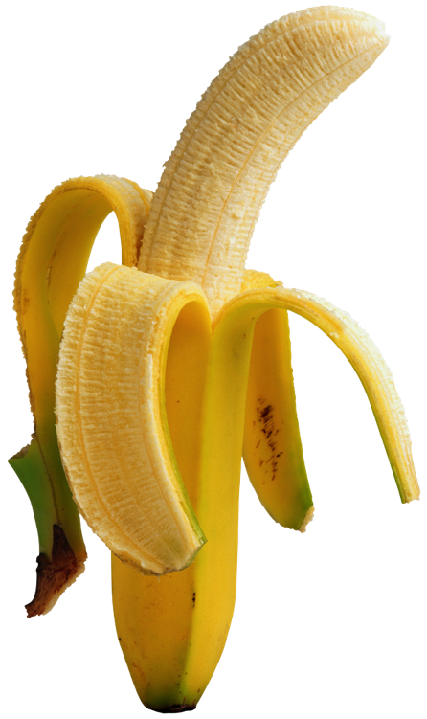
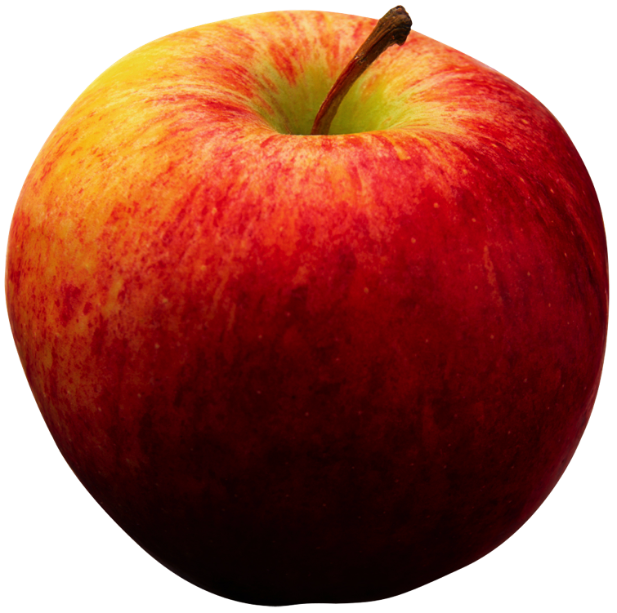
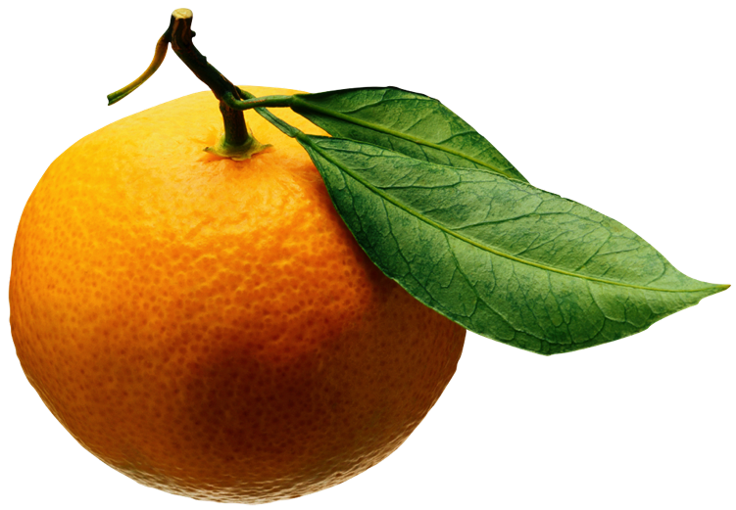
So we still fail on some tasks….
.. and we could also make more tasks that we fail on!
Our hope is that a feedback loop of:
Developing tasks that break models, and
Developing models that can solve tasks
… leads in a fruitful research direction….

Slide 59
How about on real data?
Toy AI tasks are important for developing innovative methods.
But they do not give all the answers.
How do these models work on real data?
Classic Language Modeling (Penn TreeBank, Text8)
Story understanding (Children’s Book Test, News articles)
Open Question Answering (WebQuestions, WikiQA)
Goal-Oriented Dialog and Chit-Chat (Movie Dialog, Ubuntu)

Slide 60
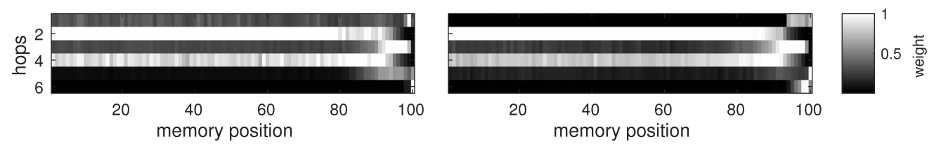
Language Modeling
The goal is to predict the next word in a text sequence given the previous words. Results on the Penn Treebank and Text8 (Wikipedia-based) corpora.
 | Penn Tree | Text8
RNN | 129 | 184
LSTM | 115 | 154
MemN2N 2 hops | 121 | 187
5 hops | 118 | 154
7 hops | 111 | 147
Test perplexity
Hops vs. Attention:
Average over (PTB)
Average over (Text8)

Slide 61
Language Modeling
The goal is to predict the next word in a text sequence given the previous words. Results on the Penn Treebank and Text8 (Wikipedia-based) corpora.
 | Penn Tree | Text8
RNN | 129 | 184
LSTM | 115 | 154
MemN2N 2 hops | 121 | 187
5 hops | 118 | 154
7 hops | 111 | 147
Test perplexity
MemNNs are in the same ballpark as LSTMs.
Hypothesis: many words (e.g. syntax words) don’t actually need really long term context, and so memNNs don’t help there.
Maybe MemNNs could eventually help more on things like nouns/entities?

Slide 65
Self-Supervision Memory Network
Two tricks together that make things work a bit better:
1) Bypass module
Instead of the last output module being a linear layer from the output of the memory, assume the answer is one of the memories. Sum the scores of identical memories.
2) Self-Supervision
We know what the right answer is on the training data, so just directly train that memories containing the answer word to be supporting facts (have high probability).

Slide 66
Results on Children’s Book Test

Slide 67
Question Answering on New’s Articles
We evaluate our models on the data from:
“Teaching Machines to Read and Comprehend”
Karl Moritz Hermann, Tomáš Kočiský, Edward Grefenstette, Lasse Espeholt, Will Kay, Mustafa Suleyman, Phil Blunsom

Slide 68
Results on CNN QA dataset

Slide 69
Latest Fresh Results
Our best results: QACNN: 69.4 CBT-NE: 66.6 CBT-V: 63.0
Text Understanding with the Attention Sum Reader Network. Kadlec et al. (4 Mar ‘16) QACNN: 75.4 CBT-NE: 71.0 CBT-CN: 68.9 Uses RNN style encoding of words + bypass module + 1 hop
Iterative Alternating Neural Attention for Machine Reading. Sordoni et al. (7 Jun ’16) QACNN: 76.1 CBT-NE: 72.0 CBT-CN: 71.0
Natural Language Comprehension with the EpiReader. Trischler et al. (7 Jun ’16) QACNN: 74.0 CBT-NE: 71.8 CBT-CN: 70.6
Gated-Attention Readers for Text Comprehension. Dhingra et al. (5 Jun ’16) QACNN: 77.4 CBT-NE: 71.9 CBT-CN: 69. Uses RNN style encoding of words + bypass module + multiplicative combination of query + multiple hops

Slide 71
WebQuestions & SimpleQuestions
Decent results on WebQuestions, a popular QA task:
A. Bordes, N. Usunier, S. Chopra J.Weston. Large-scale Simple Question Answering with Memory Networks. arXiv:1506.02075.
However now beaten by many results, especially (Yih et al. ACL ‘15) that achieves 52.5! Several hand engineered features are used in that case. Note WebQuestions is very small (4k train+valid).

Slide 72
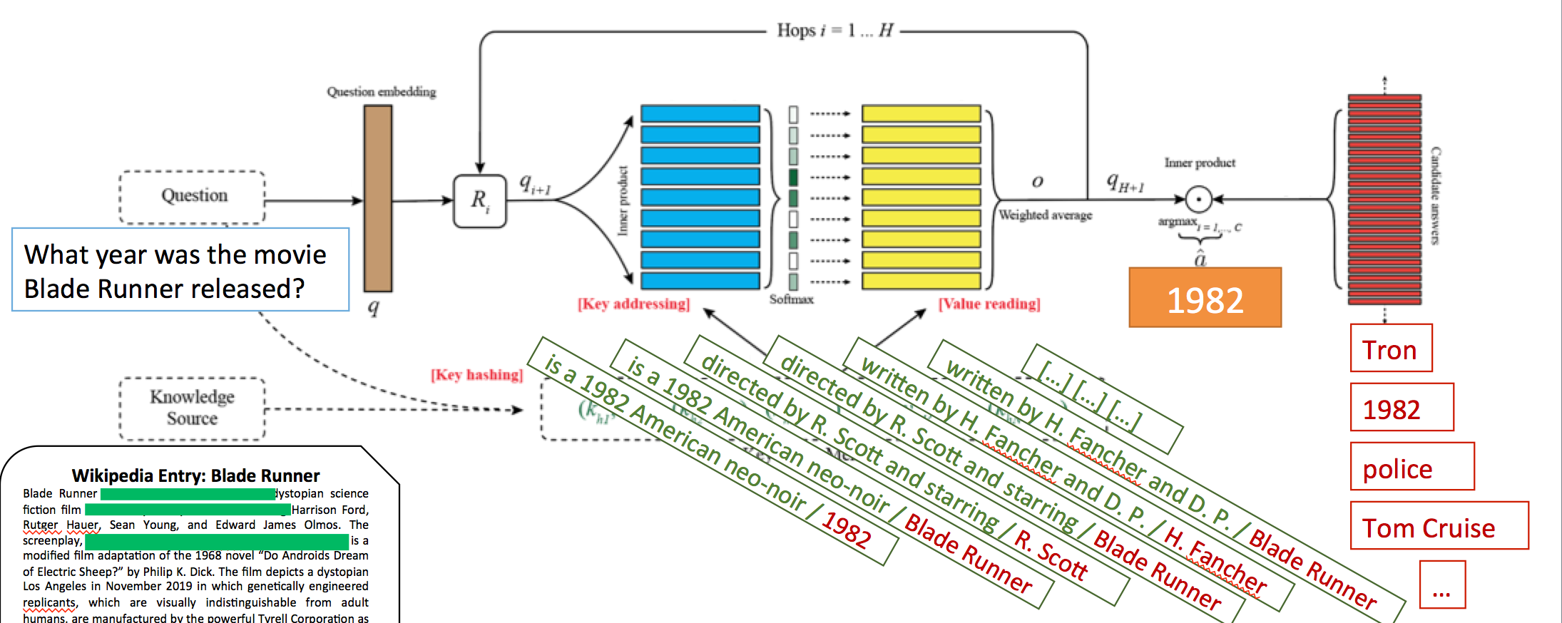
Recent Work: New Models for QA on documents Miller et al. Key-Value Memory Networks for Directly Reading Documents. arXiv:1606.03126.

Slide 73
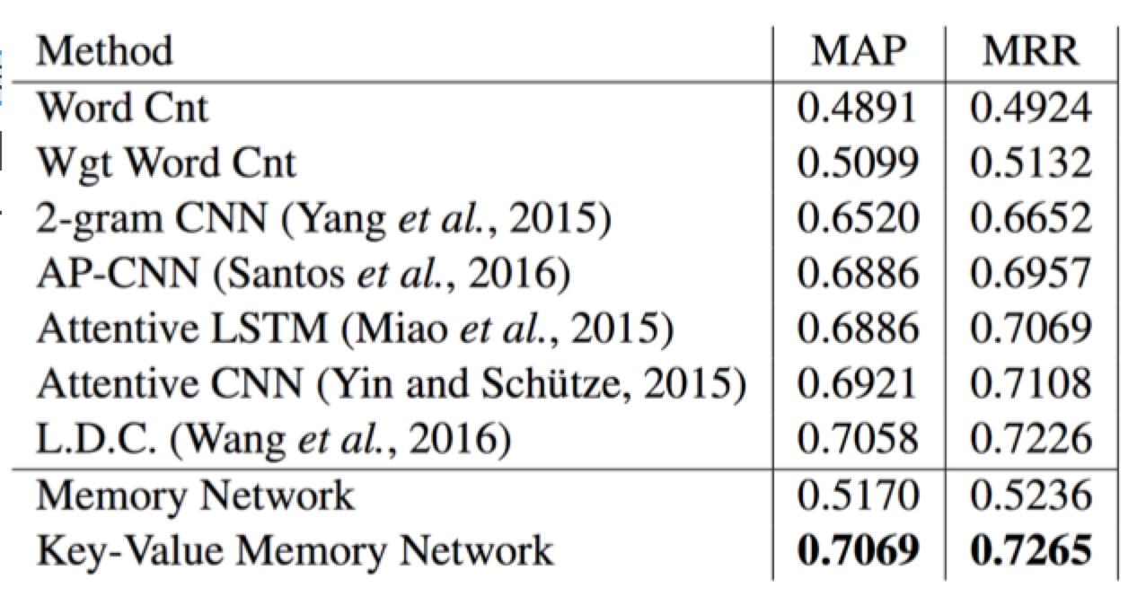
Recent Work: New Models for QA on documents Miller et al. Key-Value Memory Networks for Directly Reading Documents. arXiv:1606.03126.
WikiQA Results

Slide 74
How about on large scale dialog data? With multiple exchanges?
Everything we showed so far was question answering potentially with long-term context.
We have also built a Movie Dialog Dataset
Closed, but large, domain about movies (75k entities, 3.5M ex).
Ask facts about movies?
Ask for opinions (recommendations) about movies?
Dialog combining facts and opinions?
General chit-chat about movies (statements not questions)?
And… combination of all above in one end-to-end model.

Slide 75
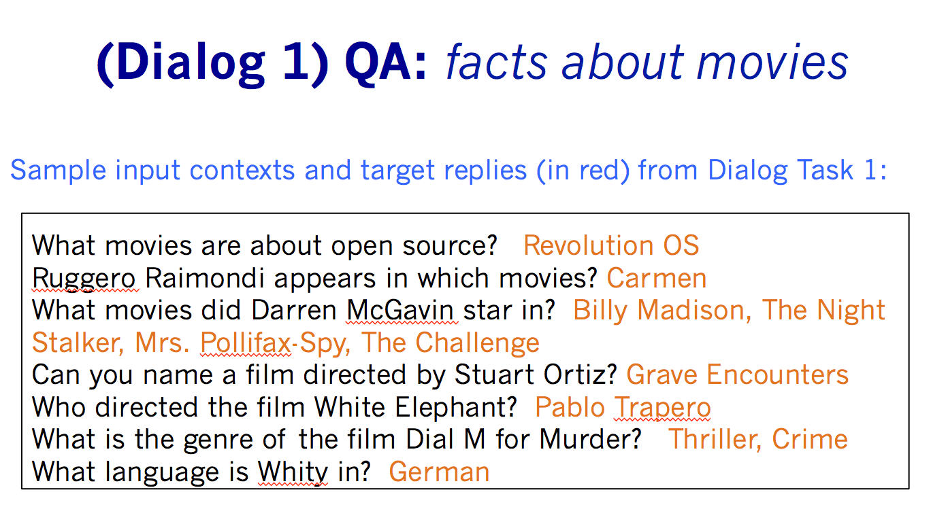
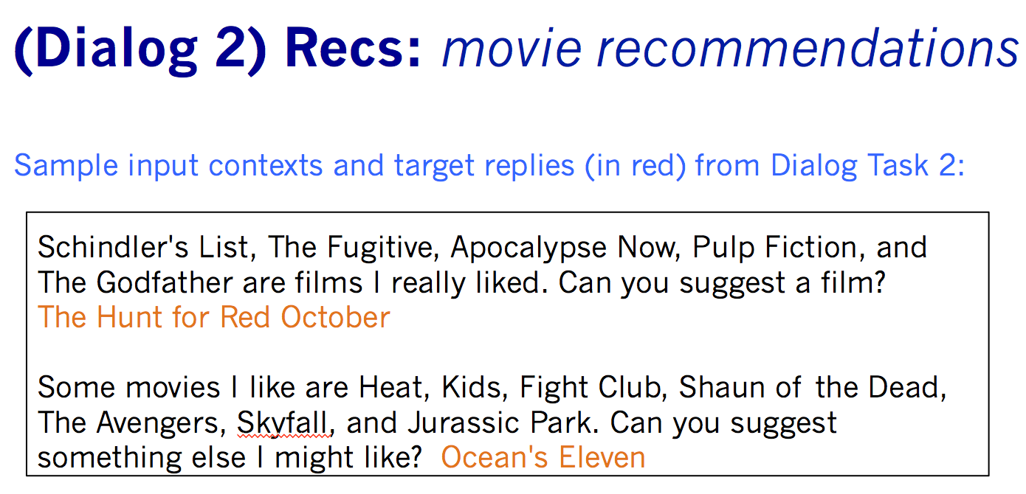
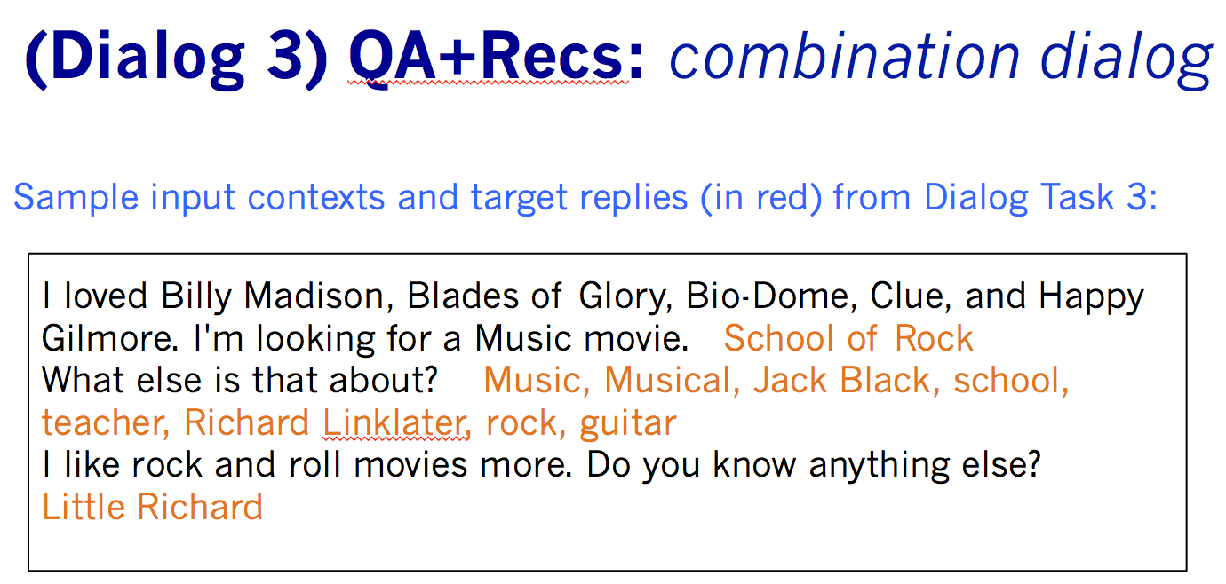
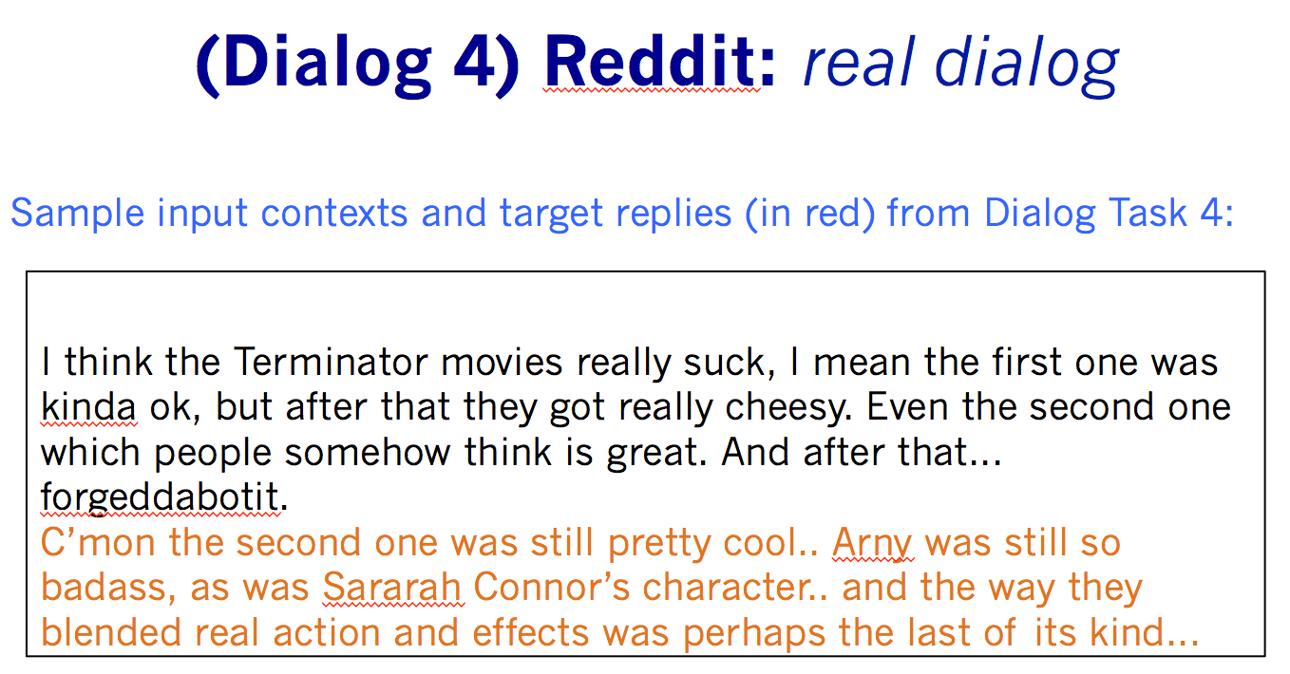
Recent Work: Combines QA with Dialog Tasks Dodge et al. “Evaluating Prerequisite Qualities for Learning End-to-End Dialog Systems.” ICLR ‘16

Slide 76
(Dialog 1) QA: facts about movies
Sample input contexts and target replies (in red) from Dialog Task 1:
What movies are about open source? Revolution OS
Ruggero Raimondi appears in which movies? Carmen
What movies did Darren McGavin star in? Billy Madison, The Night Stalker, Mrs. Pollifax-Spy, The Challenge
Can you name a film directed by Stuart Ortiz? Grave Encounters
Who directed the film White Elephant? Pablo Trapero
What is the genre of the film Dial M for Murder? Thriller, Crime
What language is Whity in? German

Slide 77
(Dialog 2) Recs: movie recommendations
Sample input contexts and target replies (in red) from Dialog Task 2:
Schindler's List, The Fugitive, Apocalypse Now, Pulp Fiction, and The Godfather are films I really liked. Can you suggest a film? The Hunt for Red October
Some movies I like are Heat, Kids, Fight Club, Shaun of the Dead, The Avengers, Skyfall, and Jurassic Park. Can you suggest something else I might like? Ocean's Eleven

Slide 78
(Dialog 3) QA+Recs: combination dialog
Sample input contexts and target replies (in red) from Dialog Task 3:
I loved Billy Madison, Blades of Glory, Bio-Dome, Clue, and Happy Gilmore. I'm looking for a Music movie. School of Rock
What else is that about? Music, Musical, Jack Black, school, teacher, Richard Linklater, rock, guitar
I like rock and roll movies more. Do you know anything else?
Little Richard

Slide 79
(Dialog 4) Reddit: real dialog
Sample input contexts and target replies (in red) from Dialog Task 4:
I think the Terminator movies really suck, I mean the first one was kinda ok, but after that they got really cheesy. Even the second one which people somehow think is great. And after that... forgeddabotit.
C’mon the second one was still pretty cool.. Arny was still so badass, as was Sararah Connor’s character.. and the way they blended real action and effects was perhaps the last of its kind...

Slide 80
Memory Network: example

Slide 81
Results

Slide 82
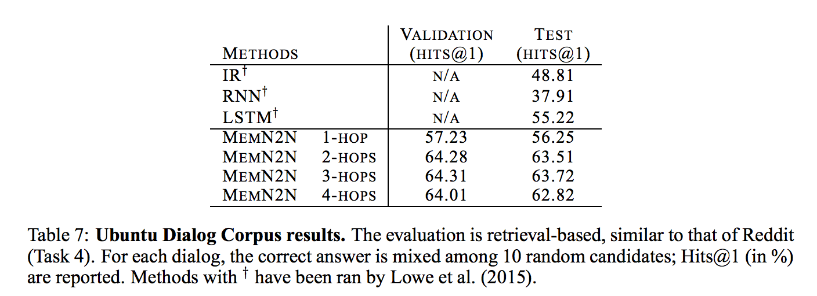
Ubuntu Data
Dialog dataset: Ubuntu IRC channel logs, users ask questions about issues they are having with Ubuntu and get answers by other users. (Lowe et al., ‘15)
Best results currently reported:
Sentence Pair Scoring: Towards Unified Framework for Text Comprehension
Petr Baudiš, Jan Pichl, Tomáš Vyskočil, Jan Šedivý
RNN-CNN combo model: 67.2

Slide 83
Next Steps
Artificial tasks to help design new methods:
New methods that succeed on all bAbI tasks?
Make more bAbI tasks to check other skills.
Real tasks to make sure those methods are actually useful:
Sophisticated reasoning on bAbI tasks doesn’t always happen as clearly on real data.. Why? Fix!
Models that work jointly on all tasks so far built.
Dream: can learn from very weak supervision:
We would like to learn in an environment just by communicating with other agents / humans, as well as seeing other agents communicating + acting in the environment.
E.g. a baby talking to its parents, and seeing them talk to each other.

Slide 84
Learning From Human Responses
Mary went to the hallway.
John moved to the bathroom.
Mary travelled to the kitchen.
Where is Mary? A:playground
No, that's incorrect.
Where is John? A:bathroom
Yes, that's right!
If you can predict this, you are most of the way to knowing how to answer correctly.

Slide 85
Human Responses Give Lots of Info
Mary went to the hallway.
John moved to the bathroom.
Mary travelled to the kitchen.
Where is Mary? A:playground
No, the answer is kitchen.
Where is John? A:bathroom
Yes, that's right!
Much more signal than just “No” or zero reward.

Slide 86
Forward Prediction
Mary went to the hallway.
John moved to the bathroom.
Mary travelled to the kitchen.
Where is Mary? A:playground
No, she’s in the kitchen.
If you can predict this, you are most of the way to knowing how to answer correctly.
See our new paper! “Dialog-Based Language Learning” arXiv:1604.06045.

Slide 87
FAIR: paper / data / code
Papers:
bAbI tasks: arxiv.org/abs/1502.05698
Memory Networks: http://arxiv.org/abs/1410.3916
End-to-end Memory Networks: http://arxiv.org/abs/1503.08895
Large-scale QA with MemNNs: http://arxiv.org/abs/1506.02075
Reading Children’s Books: http://arxiv.org/abs/1511.02301
Evaluating End-To-End Dialog: http://arxiv.org/abs/1511.06931
Dialog-based Language Learning: http://arxiv.org/abs/1604.06045
Data:
bAbI tasks: fb.ai/babi
SimpleQuestions dataset (100k questions): fb.ai/babi
Children’s Book Test dataset: fb.ai/babi
Movie Dialog Dataest: fb.ai/babi
Code:
Memory Networks: https://github.com/facebook/MemNN
Simulation tasks generator: https://github.com/facebook/bAbI-tasks

Slide 88
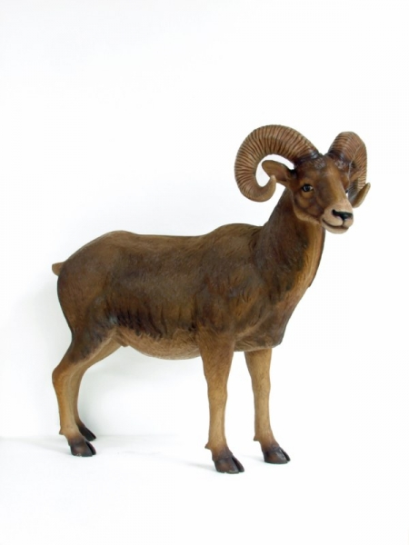
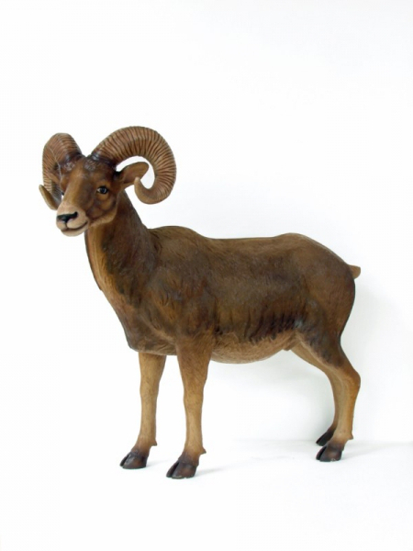
RAM Issues
How to decide what to write and what not to write in the memory?
How to represent knowledge to be stored in memories?
Types of memory (arrays, stacks, or stored within weights of model), when they should be used, and how can they be learnt?
How to do fast retrieval of relevant knowledge from memories when the scale is huge?
How to build hierarchical memories, e.g. multiscale attention?
How to build hierarchical reasoning, e.g. composition of functions?
How to incorporate forgetting/compression of information?
How to evaluate reasoning models? Are artificial tasks a good way? Where do they break down and real tasks are needed?
Can we draw inspiration from how animal or human memories work?

Slide 89
Thanks!

